Slide 1
Arkansas School Wellness Meeting
Cutter Morning Star
October 7, 2025
Prepared for Wellness Committee

Slide 2
Agenda
Call to order & welcome
Review Wellness Policy
Approval of Last year's minutes
Share overall SHI results from 2024-2025
Nurse data from each campus from 2024-2025
Chronic Absenteeism
Begin the Development of 2025-2026 Improvement Plan
Closing Comments

Slide 3

Introduction

Slide 4

https://drive.google.com/file/d/1z_f6_Milp9sMbNmcisTmFNLG_oh9-5uE/view?usp=drive_link

Slide 5
Review Wellness Policy
https://notebooklm.google.com/notebook/81c25dca-57b2-408e-945a-6bf974f27596

Slide 6










School Health Index Overview
Nutrition
Physical Activity
Encouraging healthy eating
Promoting exercise
Health Services
Providing medical care
Healthy Environment
Ensuring a safe space
Family & Community Involvement
Engaging stakeholders
Notes:
https://drive.google.com/file/d/15_Xjs_590Q2Zwlotio0UACZ4DwwIPEYd/view?usp=sharing

Slide 7


Slide 8

Attendance Matters

Slide 9
In Arkansas, chronic absenteeism is defined as a student missing 10% or more of the school year, for any reason, including excused, unexcused, and suspended absences. For a typical 180-day school year, this equates to missing 18 days of school. This definition is used by the Arkansas Department of Education.

Slide 10
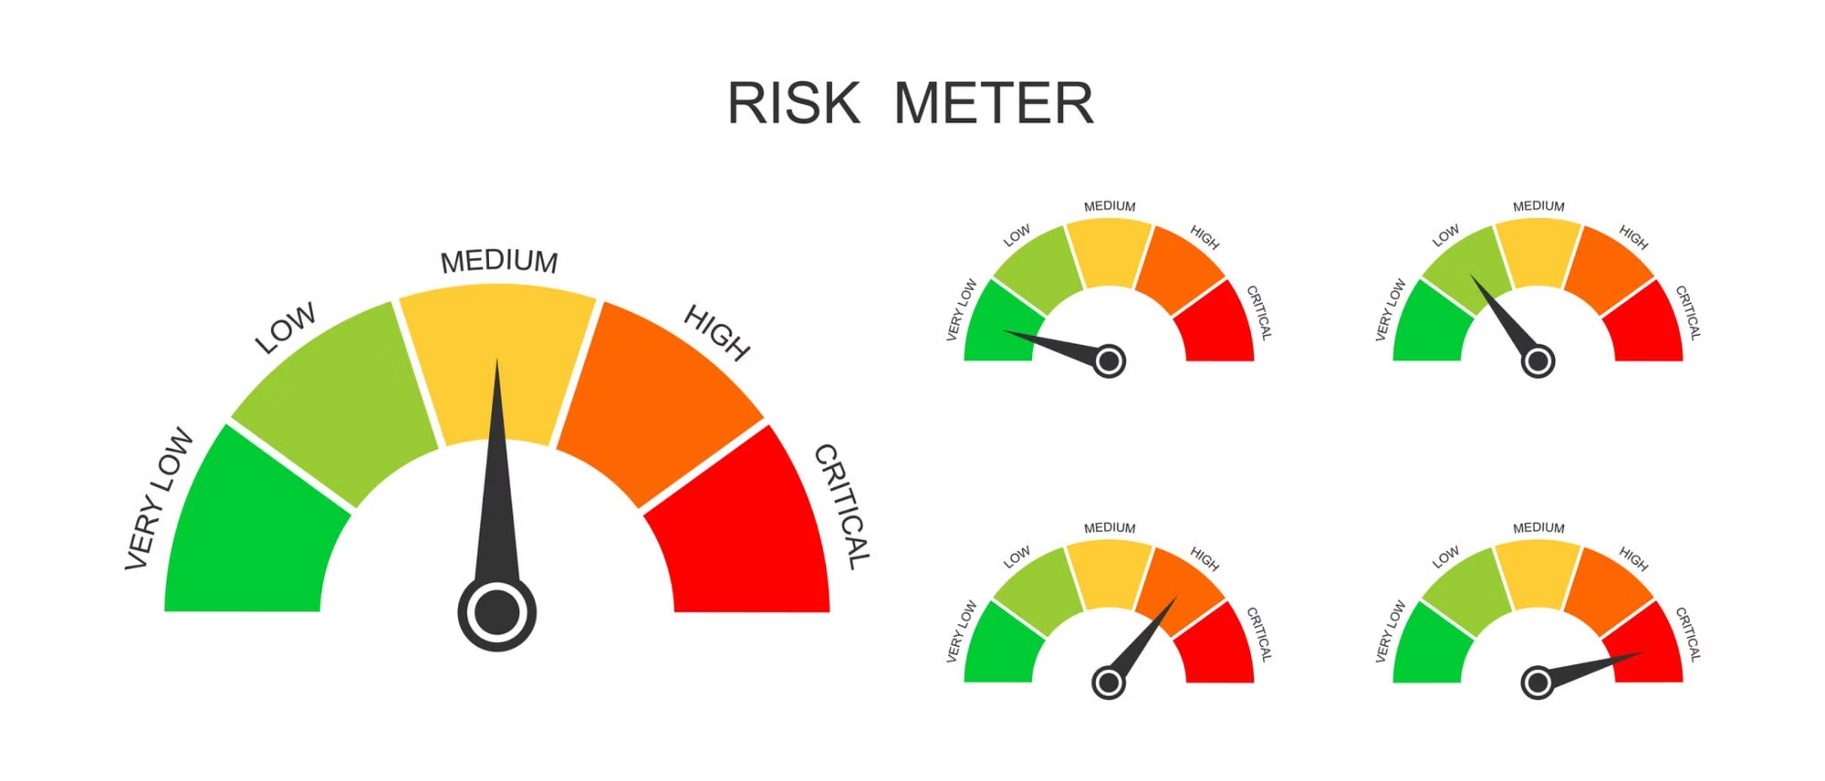
Cutter Morning Star

Slide 11
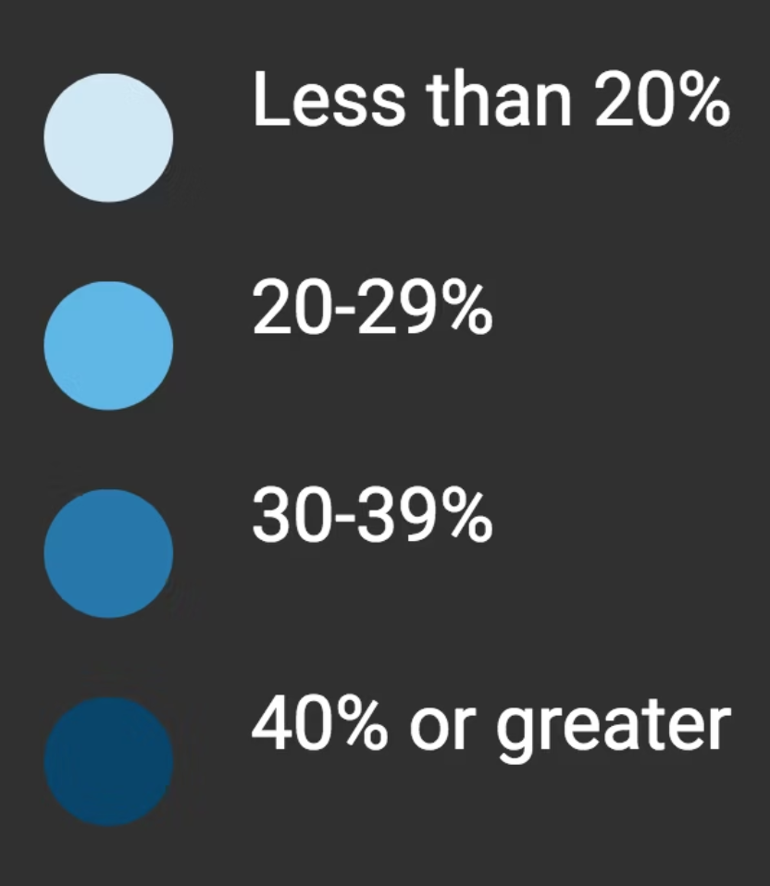
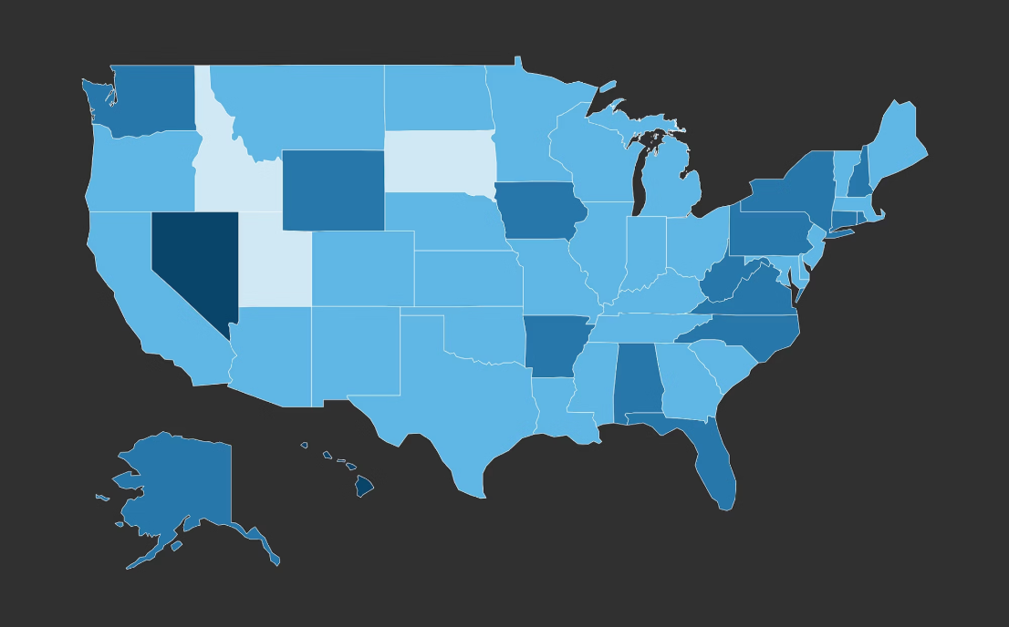
National Teacher Attendance Trends

Slide 12
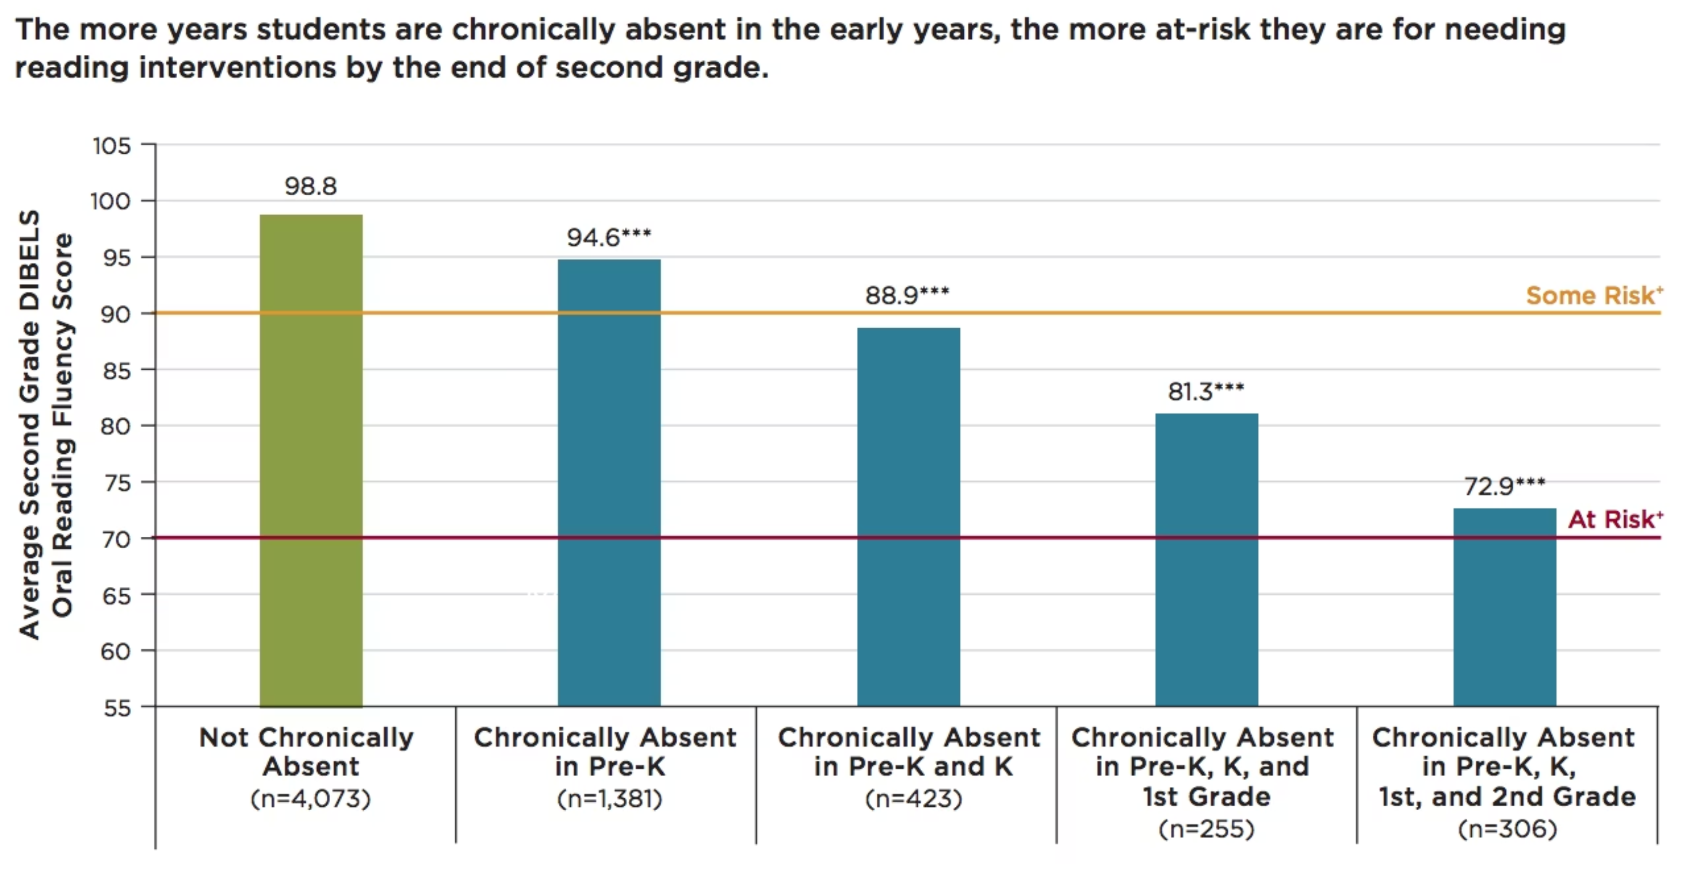

Slide 13


